Slide 1
The Heart
By: Liam Grimes and Kurtis Hausman

Slide 2
Dataset
The dataset is the Cleveland Heart Disease dataset taken from the UCI repository
Consists of 303 individuals and 14 variables (which includes a positive or negative for Heart Disease)
Some Variables include
Age and Sex
Type of Chest pain
Maximum heart rate
And More
The goal is to analyze which factors contribute to heart disease risk.
Notes:
The dataset is the Cleveland Heart Disease dataset taken from the UCI repository. The dataset consists of 303 individuals’ data. There are 14 columns in the dataset(which have been extracted from a larger set of 75). No missing values. The classification task is to predict whether an individual is suffering from heart disease or not. (0: absence, 1: presence)
Age: Patients Age in years (Numeric)
Sex: Gender (Male : 1; Female : 0) (Nominal)
cp: Type of chest pain experienced by patient. This term categorized into 4 category. 0 typical angina, 1 atypical angina, 2 non- anginal pain, 3 asymptomatic (Nominal)
trestbps: patient's level of blood pressure at resting mode in mm/HG (Numerical)
chol: Serum cholesterol in mg/dl (Numeric)
fbs: Blood sugar levels on fasting > 120 mg/dl represents as 1 in case of true and 0 as false (Nominal)
restecg: Result of electrocardiogram while at rest are represented in 3 distinct values 0 : Normal 1: having ST-T wave abnormality (T wave inversions and/or ST elevation or depression of > 0.05 mV) 2: showing probable or definite left ventricular hypertrophyby Estes' criteria (Nominal)
thalach: Maximum heart rate achieved (Numeric)
exang: Angina induced by exercise 0 depicting NO 1 depicting Yes (Nominal)
oldpeak: Exercise induced ST-depression in relative with the state of rest (Numeric)
slope: ST segment measured in terms of slope during peak exercise 0: up sloping; 1: flat; 2: down sloping(Nominal)
ca: The number of major vessels (0–3)(nominal)
thal: A blood disorder called thalassemia 0: NULL 1: normal blood flow 2: fixed defect (no blood flow in some part of the heart) 3: reversible defect (a blood flow is observed but it is not normal(nominal)

Slide 3
Data Types
Binary (4): sex, fbs, exang, target
Target is the diagnosis variable (1=Positive Diagnosis, 0 = No diagnosis)
Ordinal (5): cp, restecg, slope, ca, thal
Numeric (5): age, trestbps, chol, thalach, oldpeak
Variable Distributions →

Slide 4
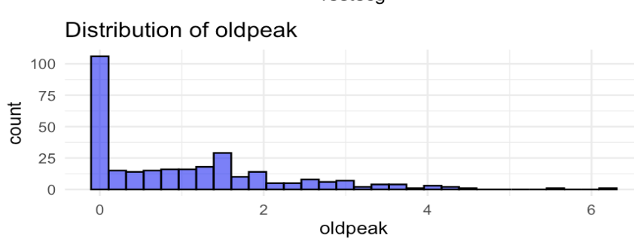
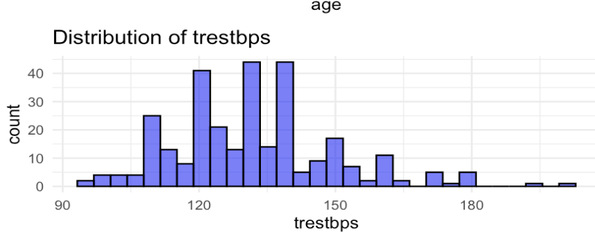
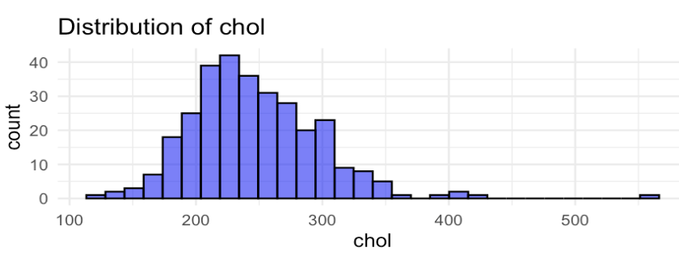
Variable Distributions
Removed:
oldpeak > 4
trestbps > 180
chol > 450.
This removed only 8 points in total

Slide 5
Relaxed Lasso Logistic Regression
Heart Disease is the cause of many people’s death across the country and the world
Although Lasso Logistic regression can be used to find a model, using Relaxed Lasso Logistic Regression, one can find the most parsimonious model
Thus leading to easier findings, allowing for quicker diagnosis before further tests
Lasso Logistic Regression will be used to determine key risk factors for heart disease
Create a model for predictions

Slide 6
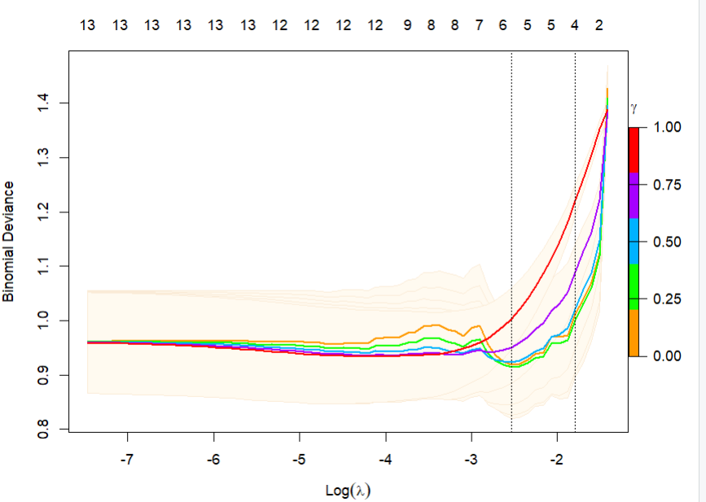
Relaxed Lasso Specifically
Extension of Lasso Regression
Variable Selection for Predictive Power
Notes:
Relaxed Lasso is an extension of Lasso regression that reduces over-shrinkage and improves prediction accuracy while maintaining feature selection
It applies Lasso first to select key variables, then relaxes the shrinkage for better predictive power

Slide 7
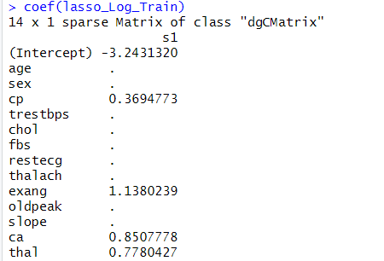
Final Model
Variable Selection Automatically
Disease = .369*ChestPaint + 1.138*Exang + 0.851*CA + .778*Thal
Notes:
This output displays the final Lasso logistic regression model, showing the variables that were selected after regularization
Lasso automatically removed variables with no strong predictive power, leaving only the most important ones
These variables are the type of Chest Pain, Angina induced by exercise, The number of major vessels, and A blood disorder called thalassemia

Slide 8

Accuracy
False Positives: 6/93
False Negatives: 4/93
Notes:
One issue with fatal diseases and creating models for prediction is that of false negatives. When testing a false negative is when the model predicts that the patient does not have the disease; however, they actually do. This is extremely dangerous when it comes to diseases, such as heart disease, that can lead to death. Therefore, I want to show that our model is accurate with an accuracy of 89%. However, an issue is the fact we have 4 false negatives. This is approximately a 4.5% which is low, but when it comes to lives the model may not be perfect. A false positive is an expensive error when it comes to money; however, this will just lead to more tests usually which then can lead to the truth about the diagnosis being found.

Slide 9
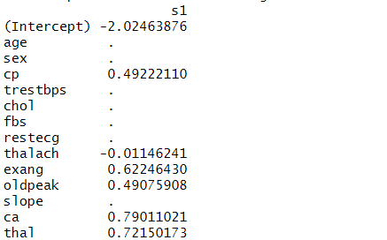
Issues from Logistic Lasso Regression
Different samples led to different models
Takeaway: Chest Pain, Thalach, Exang, Oldpeak, CA, Thal
Notes:
cp: Type of chest pain experienced by patient. This term categorized into 4 category. 0 typical angina, 1 atypical angina, 2 non- anginal pain, 3 asymptomatic (Nominal)
thalach: Maximum heart rate achieved (Numeric)
exang: Angina induced by exercise 0 depicting NO 1 depicting Yes (Nominal)
oldpeak: Exercise induced ST-depression in relative with the state of rest (Numeric)
ST depression refers to an abnormality observed on an electrocardiogram (ECG) where the ST segment appears lower than the baseline.
Higher rating means oxygen isn’t getting to heart during exercise
ca: The number of major vessels (0–3)(nominal)
thal: A blood disorder called thalassemia

Slide 10
Factor Analysis
Mixed Correlation Matrix
Multiple exploratory FAs resulting in a final CFA
Extracted Factor scores as LASSO regression coefficients
Used LASSO model to run predictions to
The goal of this factor analysis was to determine latent factors that can help us to better classify Heart Disease as well as understand the relationships that our predictors are telling us

Slide 11
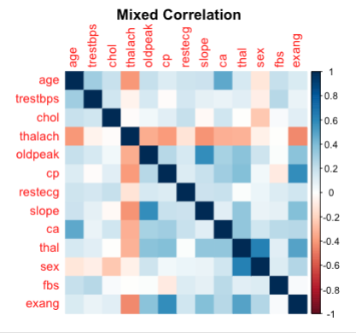
Correlations
Notes:
Due to the combination of Numeric, Binary and Ordinal Variables I determined using a mixed correlation of (Polyserial + Polychoric + Pearson)

Slide 12
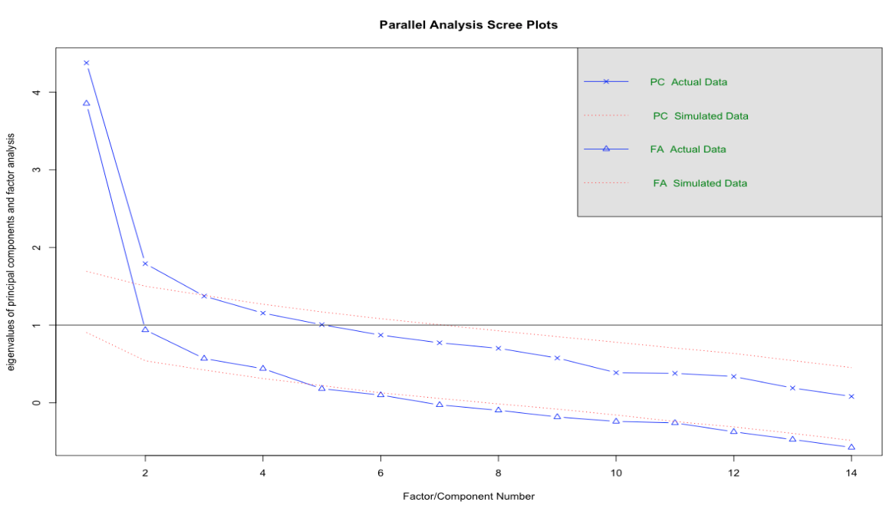
Parallel Analysis
Notes:
I determined that 5 factors is the optimal number of factors

Slide 13
Preliminary FAs
I used a cutoff of 0.5 to reduce cross loadings and make interpretable, parsimonious factors
FA 1: Exploratory Factor Analysis using no rotation
Parallel Analysis
FA 2: Common Factor Analysis using no rotation
Factors had overlapping variables
Total variance was only 0.527
FA 3: Common Factor Analysis using VARIMAX rotation
Factors had distinct variables
Certain predictors were lacking representation infactors
Total variance was only 0.527

Slide 14
Testing for FA suitability
Used KMO and Bartlett’s test for Sphericity:
Overall KMO: 0.646 (FA is somewhat suitable, but we can improve)
Chi-Square: 110.801
P-value: <2*10^-16 (Extremely significant)
KMO Individual Measures:
sex (0.424), chol (0.478), restecg(0.500), trestbps(0.517), fbs (0.550)
I then ran a final CFA with these variables removed

Slide 15
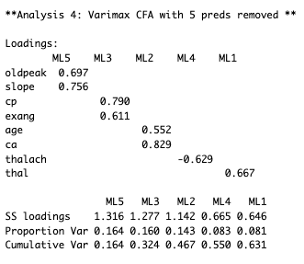
Final FA
FA 4: Common Factor Analysis using…
VARIMAX rotation
5 predictors removed
Results:
All distinct factors
All remaining variables represented in factors
Total variance = 0.631
Not ideal, but much improved
Notes:
Interpreting the final FA:

Slide 16
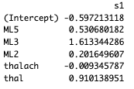
Factor Scores → LASSO
I used the factor scores with multiple variables to create a LASSO regression model
I included the variables that were there own factors as predictors in their variable state
Coefficient Estimates:
ML5 = oldpeak + slope
ML3 = cp + exang
ML2 = age + ca

Slide 17
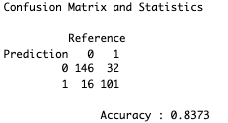
Factor Scores LASSO Predictive Power
Accuracy: 0.8373
We have double the amount of false positives than we do false negatives. This is incredibly worrisome as diagnosing someone who actually has heart disease with a negative diagnosis is extremely risky.

Slide 18
Factor Score LASSO vs. Traditional LASSO
Our results for Factor Score LASSO are much worse than the traditional LASSO regression because of the result of extremely high false negatives.
We could use these factors to examine further but using the scores themselves as predictors does not yield strong results

Slide 19
What does this mean?
When looking at both models, we can see an overlap of certain variables:
The type of Chest Pain
If Angina is induced from exercise
Factors such as Sex and Serum Cholesterol, surprisingly have no effect on heart disease in either model.

Slide 20
Final Thoughts
Test, Test, Test

